Slide 1
Deekays Money Manager
Tutorial on How To Use It:-
Press Enter To Start……

Slide 2
With This Software You Can Keep Record
Of Your Pocket Money And
Where You Spend Your Money
Press Enter To Conti……

Slide 3
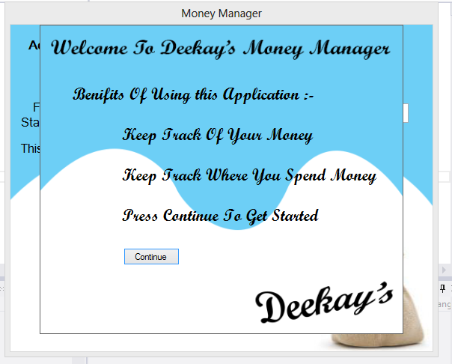
When You Start Application First Time
You Get a Window Like This
Press Continue
Button

Slide 4
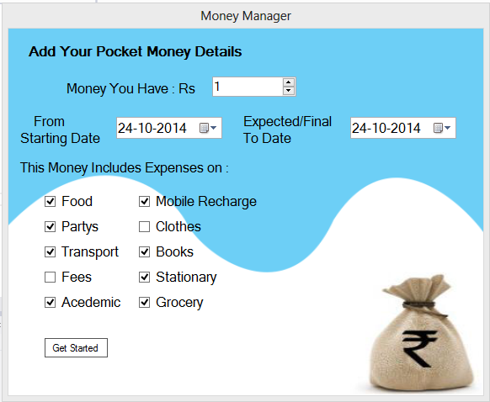
Then you Get This Window
Enter Money You Have
Then Add Starting Date

Slide 5
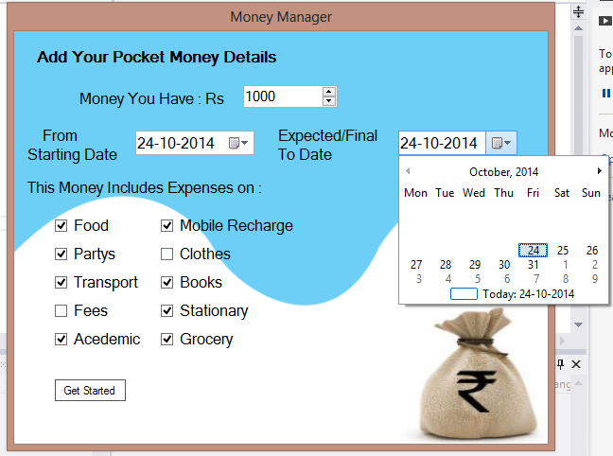
And Add Date Upto Which You Expect Money to Last

Slide 6
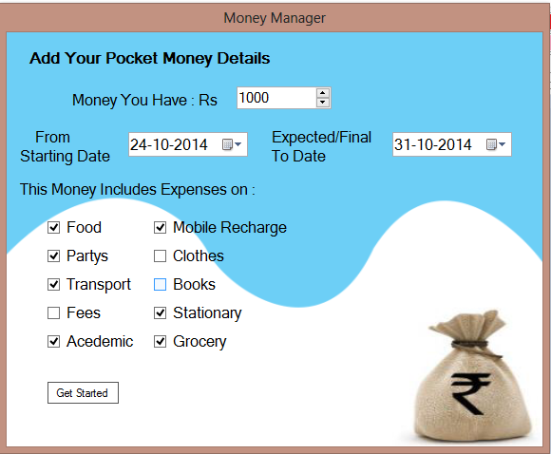
And Select Expenses Which are included in This Money
Check or Uncheck Categories as you Requirements
And Press Get Started Button

Slide 7
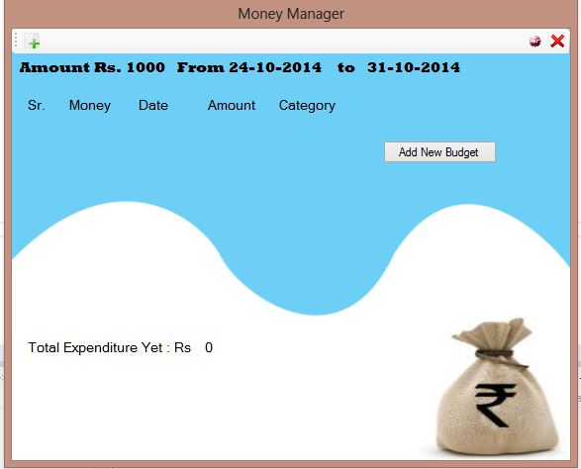
Then You Get Something Like This

Slide 8
Then You Get Something Like This
This is Your Budget
Details
This is Area Where
Your Expenses Details
Will Be shown
This Will Show Your Status

Slide 9
This Area is Empty
Yet As You Hvnt
Added Anything
To Add Click New Event Button

Slide 10
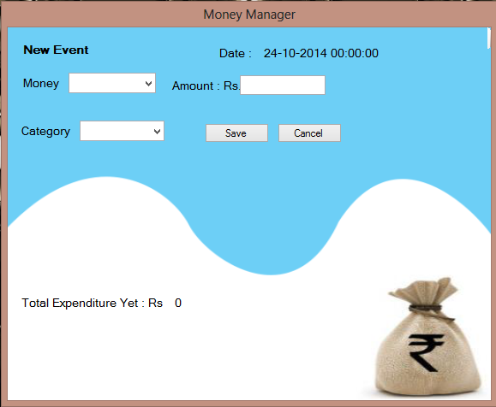
On Clicking New Event Button You Get This Window

Slide 11
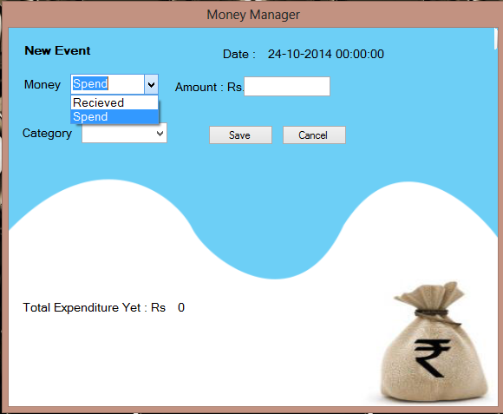
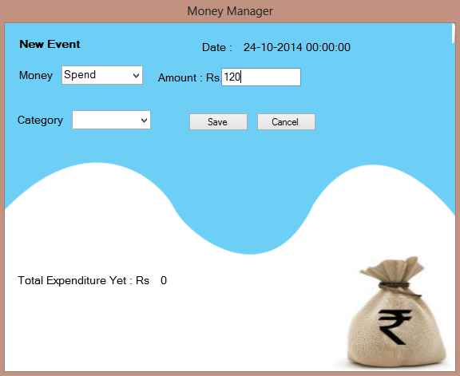
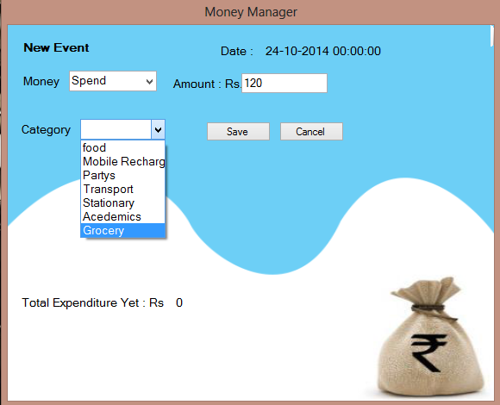
Fill Event Details
Money Status
Amount
And Select Category
And Press Save To Add

Slide 12
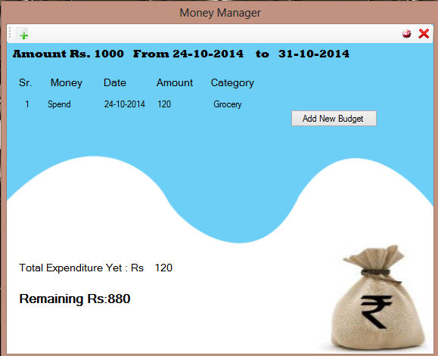
And Event Will Be Added
You Can Daily Add You Expenses

Slide 13
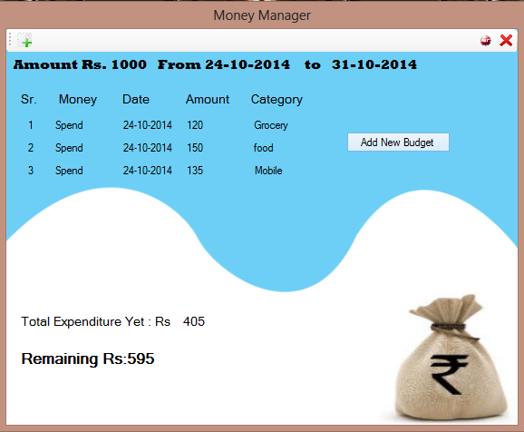

Slide 14
To End This Budget Plan And Start New Click
Add New Budget Button
And You Can Start New Budget
As Previously

Slide 15
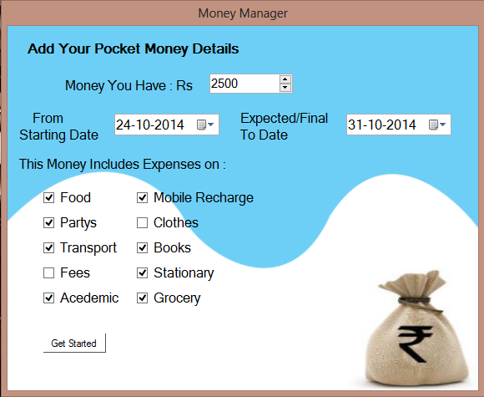
Adding New Budget

Slide 16
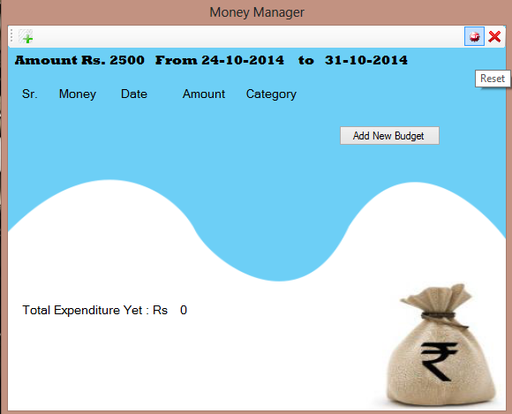
If At Any Condition You Are Getting Error About Application
or You wanna Start Everything New Click Reset Button

Slide 17

To Close App Click Close Button

Slide 18
Hope You’d Like The Application
Your Query/Suggestions/Advice
Are Welcomed
You can Contact at
dishantdkc@gmail.com
A Deekays Application
By Dishant Kumar

